Slide 1

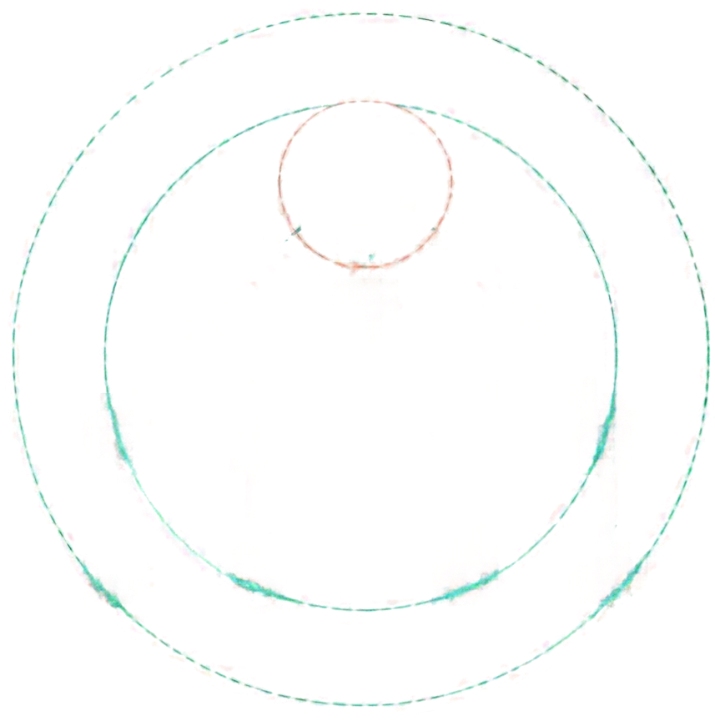

























Breadth-First Search (BFS)
A
level-order graph traversal
from a source
B
C
D
DAA CA-3 Component 2
E
F
G
H
I
PRN 25070521291
SEC E (E2)
NAME SOUMYA FAYE
J
K
L
M
unweighted shortest paths
queue-based exploration
graph traversal
complexity analysis

Slide 2



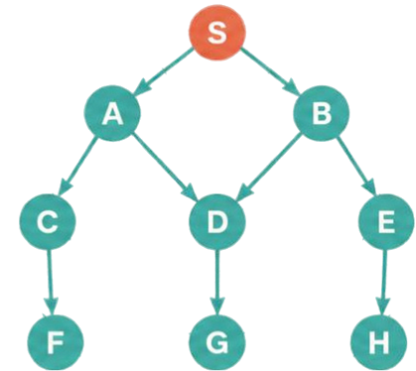



What Is BFS?
Level 0
distance 0
Core Idea and Uses
Level 1
distance 1
BFS explores a graph
level by level
Level 2
distance 2
visiting all vertices at distance 0, then 1, then 2, and so on from the source.
Level 3
It uses a
distance 3
First-In, First-Out (FIFO) queue
to manage the frontier.
In unweighted graphs,
BFS finds shortest paths
Network broadcasting
Where BFS Excels
in terms of number of edges.
Social-network degrees
BFS works on both
Web crawling
directed and undirected graphs
Maze solving
direction determines which edges can be followed.
Connectedcomponent discovery

Slide 3

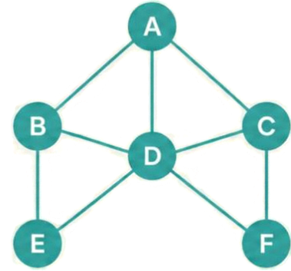















Graph Representation, Queue and Visited State
Adjacency List
A
B
C
D
E
F
A graph G = (V, E) is stored using adjacency lists
for efficient traversal.
BFS explores level by level using a
FIFO queue.
FIFO Queue
Visited / Discovered
parent
dist
Mark a vertex discovered
when enqueuing it to avoid duplicates.
{ A, B, C, D, E, F }
Track each vertex with
parent and distance
values from the source.
Front
Rear
discovered when enqueued
enqueue at rear
dequeue from front

Slide 4













BFS Algorithm
BFS(G,S) :
INITIALIZE
Mark all vertices undiscovered.
Set source distance to 0.
for each v in V:
visited[v] = false
dist[v] = -1
parent[v] = NIL
DEQUEUE
Remove a vertex u from the front
of the queue.
visited[s] = true
dist[s] = 0
enqueue(0, s)
SCAN
Inspect each neighbor v
of u.
while Q not empty:
u = dequeue(0)
DISCOVER
If v is undiscovered, mark it, set parent[v] = u and dist[v] = dist[u] + 1.
v in Adj[u]:
visited[v] = true
dist[v] = dist[u] + 1
parent[v] = u
enqueue(0, v)
ENQUEUE
Add v to the back of
the queue.
TERMINATE
When the queue is empty,
all reachable vertices are explored.

Slide 5


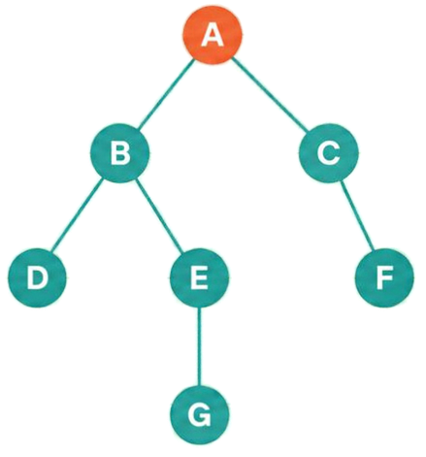











Worked Example
Level 0
distance 0
Trace the Queue by Levels
Level 1
distance 1
Breadth-First Search starting at A
Step
Dequeue
Discovered
Queue After Step
Level 2
distance 2
0
—
Start at A (L0)
[A]
1
A
B (L1), C (L1)
[B, C]
Level 3
2
B
D (L2), E (L2)
[C, D, E]
distance 3
3
C
F (L2)
[D, E, F]
4
D
–
[E, F]
BFS Visit Order
Levels
Parent Links
5
E
G (L3)
[F, G]
A, B, C, D, E, F, G
L0 = {A}
B ← A
C ← A
6
F
–
[G]
L1 = {B, C}
D ← B
neighbors considered in the listed order
L2 = {D, E, F}
E ← B
7
G
–
[]
L3 = {G}
F ← C
G ← E

Slide 6



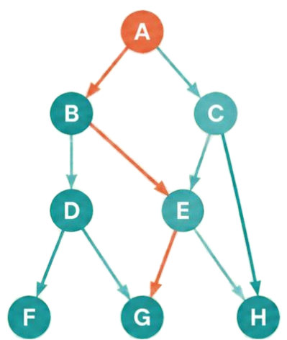

Shortest Paths and Reconstructing a Route
Vertex
Parent
BFS discovers vertices in nondecreasing distance order.
A
B
C
D
E
F
G
H
–
A
A
B
B
D
E
C
The first time a vertex is found gives the fewest number of edges from the source.
Shortest path A to G: A → B → E → G
Reconstruct the route by following parent pointers from the destination back to the source, then reverse.
Reconstruct A → G
Start at G: G ← E ← B ← A
BFS minimizes the number of edges, not total
travel cost with weighted edges.
Reverse: A → B → E → G

Slide 7





Time and
Space Complexity
ADJACENCY LISTS
ADJACENCY MATRICES
O(V + E)
O(V²)
Each vertex is enqueued at most once.
Each edge is examined
at most once (or twice in an undirected adjacency list).
Every possible neighbor entry may be checked
for each vertex.
BFS runs in linear time
with adjacency lists, and quadratic time
with adjacency matrices.
It uses linear extra space for the queue
and bookkeeping arrays.
AUXILIARY SPACE
DISCONNECTED GRAPHS
To visit all vertices in a disconnected graph, start BFS from each unvisited vertex.
Sparse graphs benefit from adjacency lists.
O(V)
One BFS reaches only the source component.
Run BFS from each unvisited vertex to traverse the entire graph.
Overall: O(V + E) with adjacency lists.
For the queue, visited, distance, and parent arrays.
Graph storage is separate.

Slide 8








Common Pitfalls, Variants and Applications
COMMON PITFALLS
VARIANTS
Mark visited when enqueuing,
not when queueing
Use a FIFO queue — a stack
changes the traversal order
Neighbor order affects visit order,
not shortest distances
For disconnected graphs,
restart BFS from each
unvisited vertex
Multi-source BFS enqueues
all sources with distance 0
to get nearest-source
distances
APPLICATIONS
Unweighted
route finding
Social network
degrees
Broadcasting
and spreading
Maze shortest paths
Bipartite
checking
Level-order
tree traversal

Slide 9




BFS vs DFS vs Dijkstra
Choosing the Right Algorithm
BFS
DFS
Dijkstra
Best for
Unweighted shortest paths (minimum number of edges)
Reachability, cycle detection, topological workflows
Shortest paths with
nonnegative edge weights
Core mechanism
First-In, First-Out queue
Stack or recursion
Min-priority queue
Time complexity
O(V + E) with adjacency lists
O((V + E) with adjacency lists
O((V + E) log V) with a
binary heap
All edges have equal cost and you want the minimum
number of edges
Exploring depth-first structure, detecting cycles, or producing topological order
Weighted graphs with nonnegative edge weights
When to choose
Key takeaway
Discover each vertex once, enqueue it once, process level by level, and use parent pointers to recover paths.
Generated using Canva • Source material attribution: NotebookLM.

